Slide 1
SPAM CLASSIFIER USING NLP
6 MONTHS INDUSTRIAL TRAINING PRESENTATION
-TUSHAR MAHAJAN
2016ECA1112
B(TECH). ECE SEM VIII

Slide 2
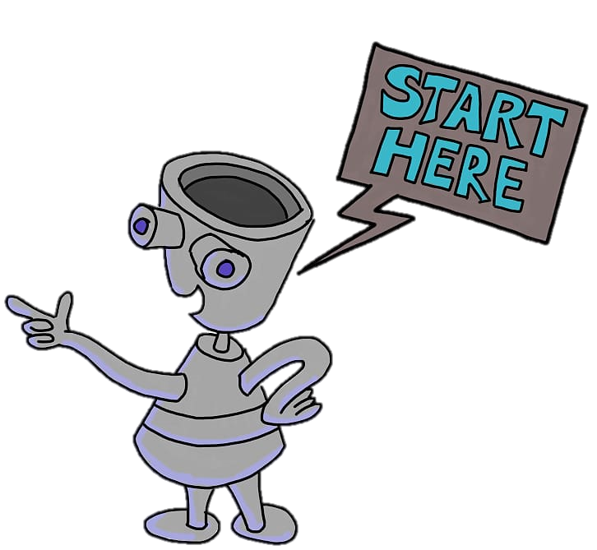
CONTENTS:
Objective
What is SPAM?
What is SPAM FILTER?
Natural Language Processing?
Tools Used.
Models Deployed.
Steps Involved.
Screen Shots.
Future Work.
THANK YOU!

Slide 3

OBJECTIVE
“To get a suitable models which can be used to specify the messages as SPAM or HAM (not spam)”

Slide 4
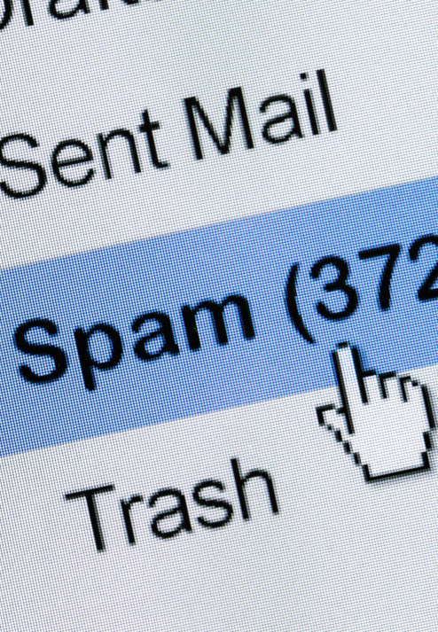
SPAM?
Spamming is the use of messaging systems to send an unsolicited message, especially advertising, as well as sending messages repeatedly on the same website.

Slide 5
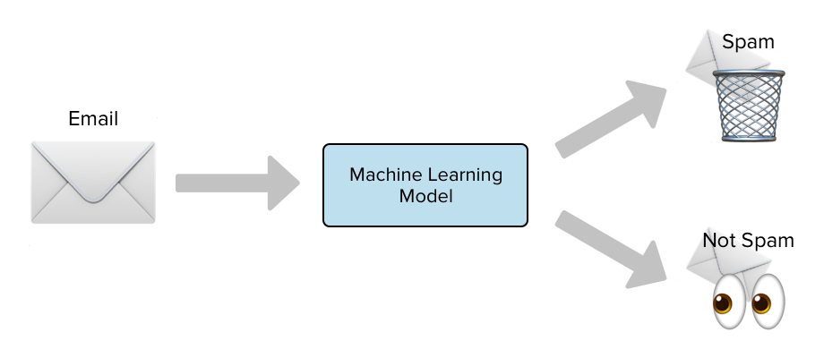
WHAT IS A SPAM FILTER?
The SPAM CLASSIFIER/ FILTER is defined ad the system of methods with which the spam and ham is differentiated using different techniques and the words which are being used in it.
We make use of NATURAL LANGUAGE PROCESSING (NLP) for this purpose.

Slide 6
1.
NATURAL LANGUAGE PROCESSING
Let’s start with a brief explanation of the same.

Slide 7

“Natural Language Processing or NLP is a field of Artificial Intelligence that gives the machines the ability to read, understand and derive meaning from human languages.”

Slide 8
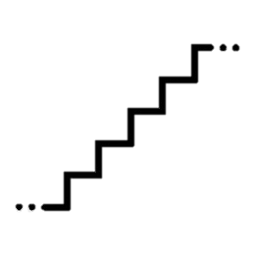
THERE ARE VARIOUS STEPS INVOLVED:
Pre-processing of Data.
Removing punctuations, stop-words, unnecessary words/strings, tokenization, lemmatization, stemming.
Feature Extraction.
Tokenization, bag of words (BoW), Lemmatization, Stemming.
After the basic NLP is applied on the data, we do the train-test split and then we do the model application and in the end compare the various models implemented.

Slide 9
PRE PROCESSING
The initial processing when the data is encountered.

Slide 10

DATA CLEANING & PREPROCESSING:
Removing/Replacing Nulls, NaNs etc.
Firstly, the data is described and all the NULLs, NaNs etc. are removed using various techniques.
String Reduction and basic cleaning:
After this string is first converted to lower, then removing unwanted punctuations, characters, strings.
Removing stop-words, tokenizing etc.
Here the data is used converted to a corpus and then data is cleaned and stop-words are removed and then Tokenization is there.

Slide 11
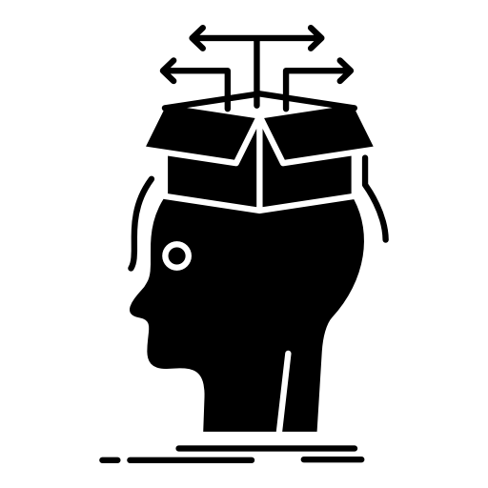
FEATURE EXTRACTION:
Bag of Words (BoW):
It is a commonly used model that allows you to count all words in a piece of text. Basically it creates an occurrence matrix for the sentence.
Lemmatization:
Lemmatization resolves words to their dictionary form (known as lemma) for which it requires detailed dictionaries in which the algorithm can look into and link words to their corresponding lemmas.
Stemming:
Stemming is the process of reducing a word to its word stem that affixes to suffixes and prefixes or to the roots of words known as a lemma.

Slide 12

TOOLS USED:
Python
Python is a programming language that lets you work quickly and integrate systems more effectively.
Jupyter Notebook
The Jupyter Notebook is an open-source web application that allows you to create and share documents that contain live code, equations, visualizations and narrative text.
Anaconda
Anaconda is a free and open-source distribution of the Python and R programming languages for scientific computing, that aims to simplify package management and deployment.

Slide 13

2.
VARIOUS ML MODELS DEPLOYED
It includes Naïve Bayes, KNN, Decision Tree & Logistic Regression.

Slide 14
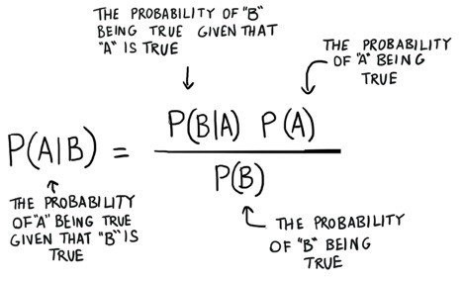
NAÏVE BAYES
It is a classification technique based on Bayes’ Theorem with an assumption of independence among predictors. In simple terms, a Naive Bayes classifier assumes that the presence of a particular feature in a class is unrelated to the presence of any other feature.

Slide 15
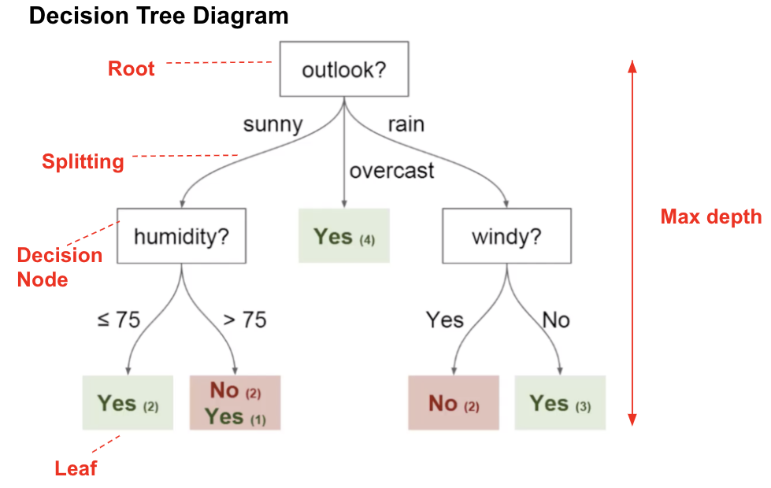
DECISION TREE
Decision Tree is one of the easiest and popular classification algorithms to understand and interpret. The goal of using a Decision Tree is to create a training model that can use to predict the class or value of the target variable by learning simple decision rules inferred from prior data (training data).

Slide 16
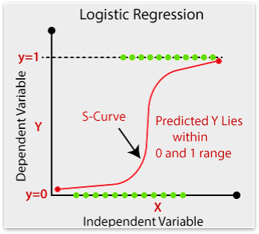
LOGISTIC REGRESSION
Logistic Regression is a Machine Learning algorithm which is used for the classification problems, it is a predictive analysis algorithm and based on the concept of probability.

Slide 17
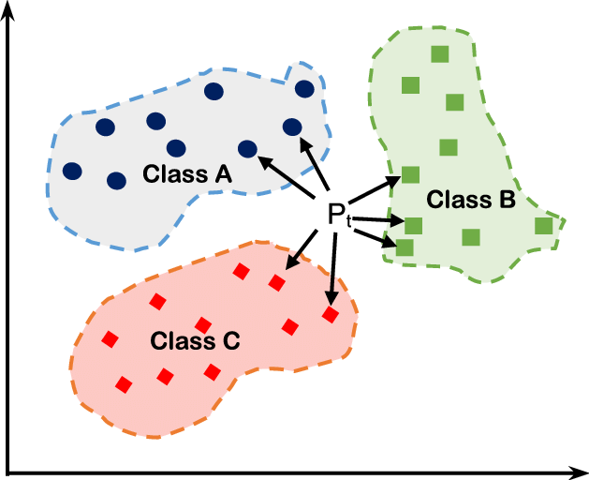
K- NEAREST
NEIGHBOR
KNN algorithm is one of the simplest classification algorithms and it is one of the most used learning algorithms. Its purpose is to use a database in which the data points are separated into several classes to predict the classification of a new sample point.

Slide 18

PROCESS INVOLVES:
Cleaning & Pre-processing of data
Feature Extraction
Basic Visualization
Application of various models
Comparison of Accuracies

Slide 19
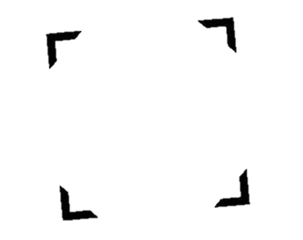
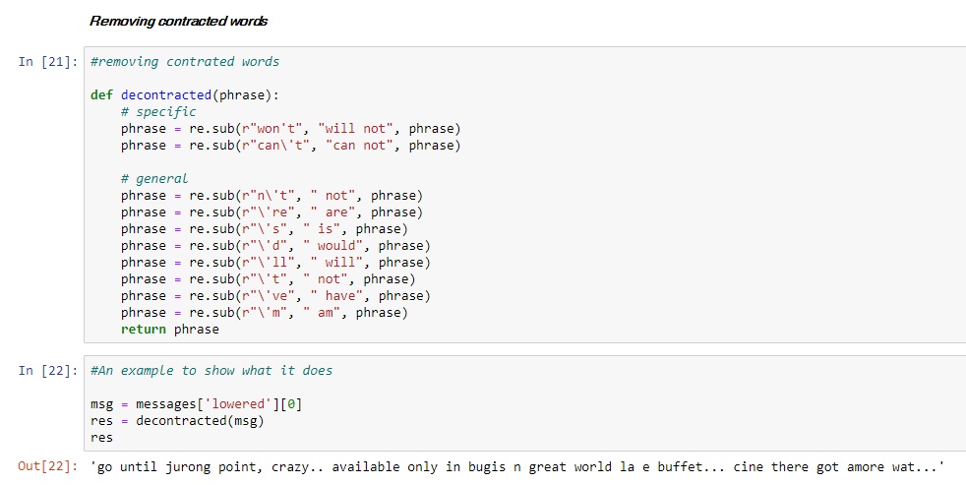
SCREENSHOTS
Function creation and application

Slide 20
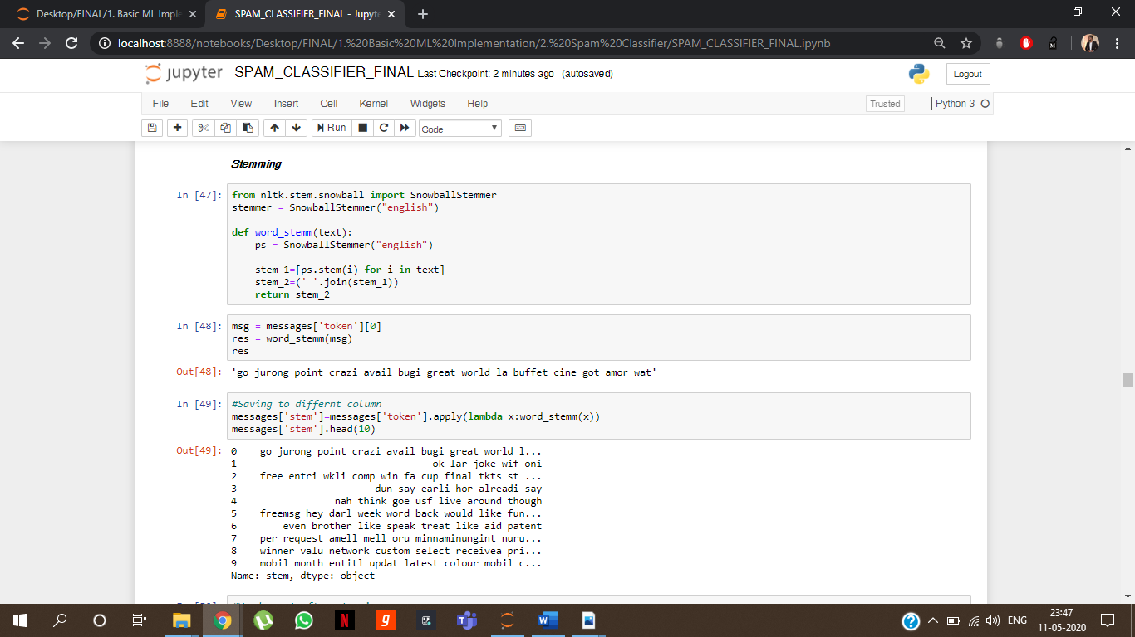
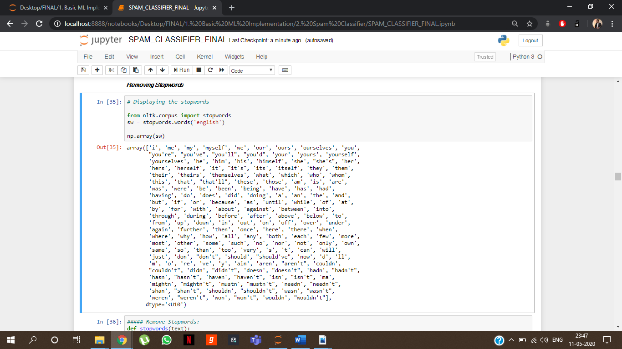
SCREENSHOTS
Stemming & Stop-word Functions

Slide 21
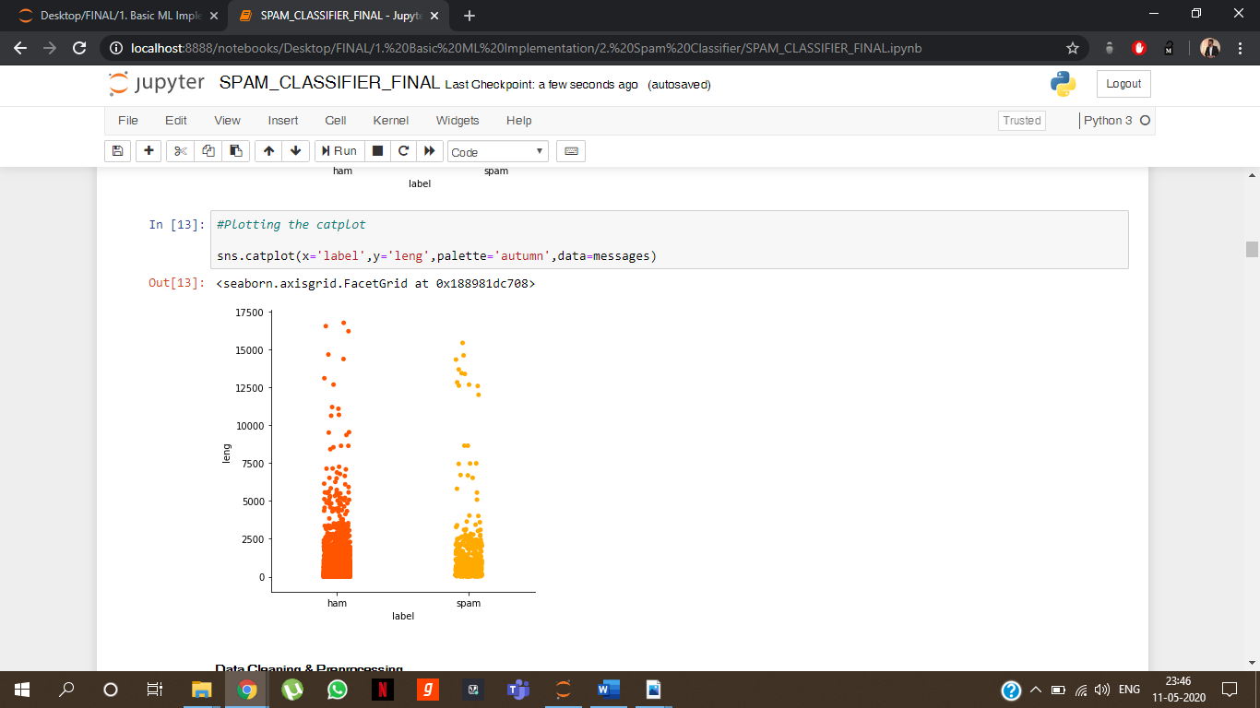
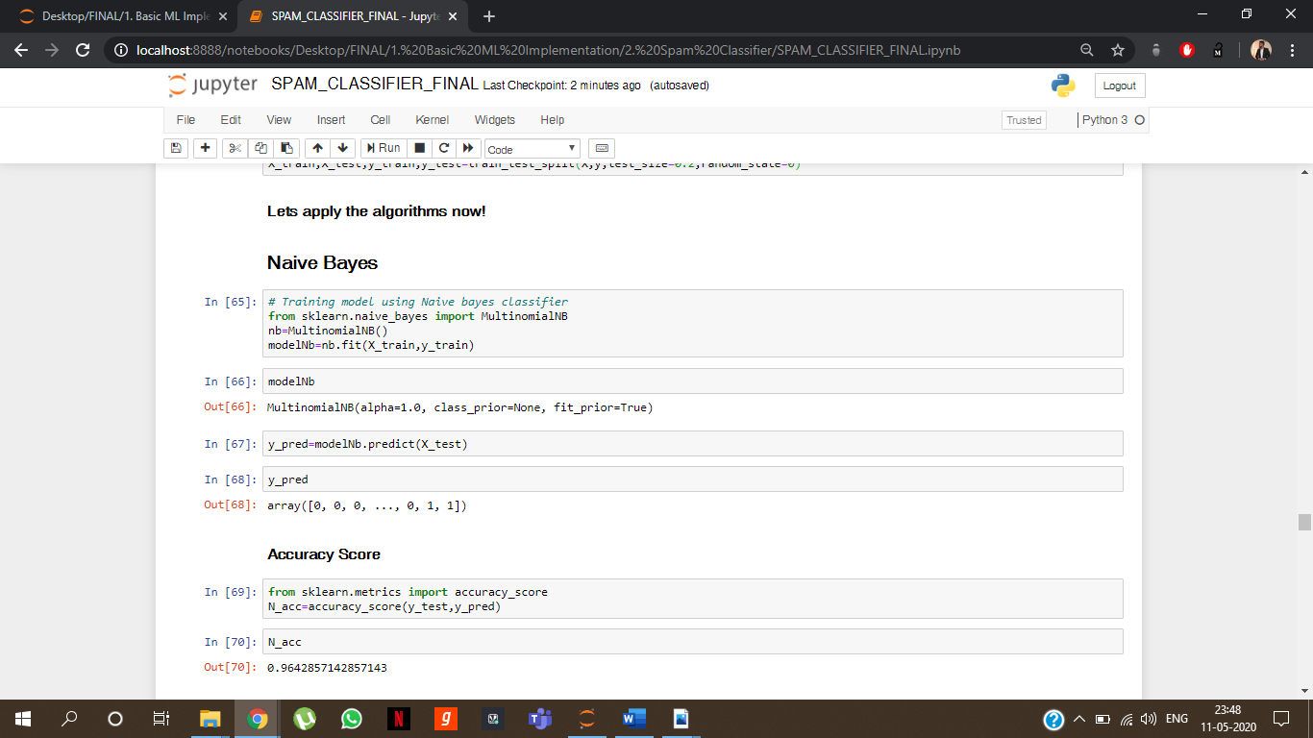
SCREENSHOTS
Basic Visualization & Model creation and application

Slide 22
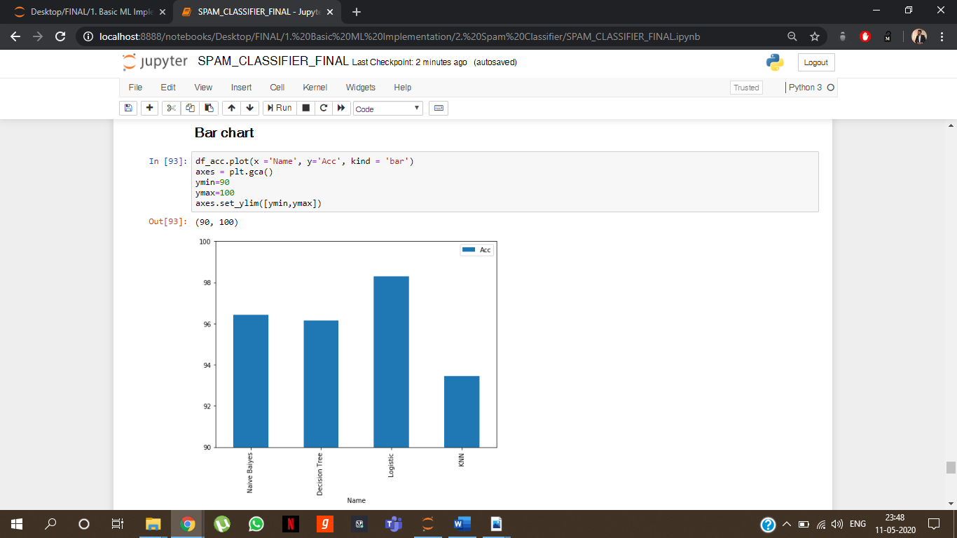
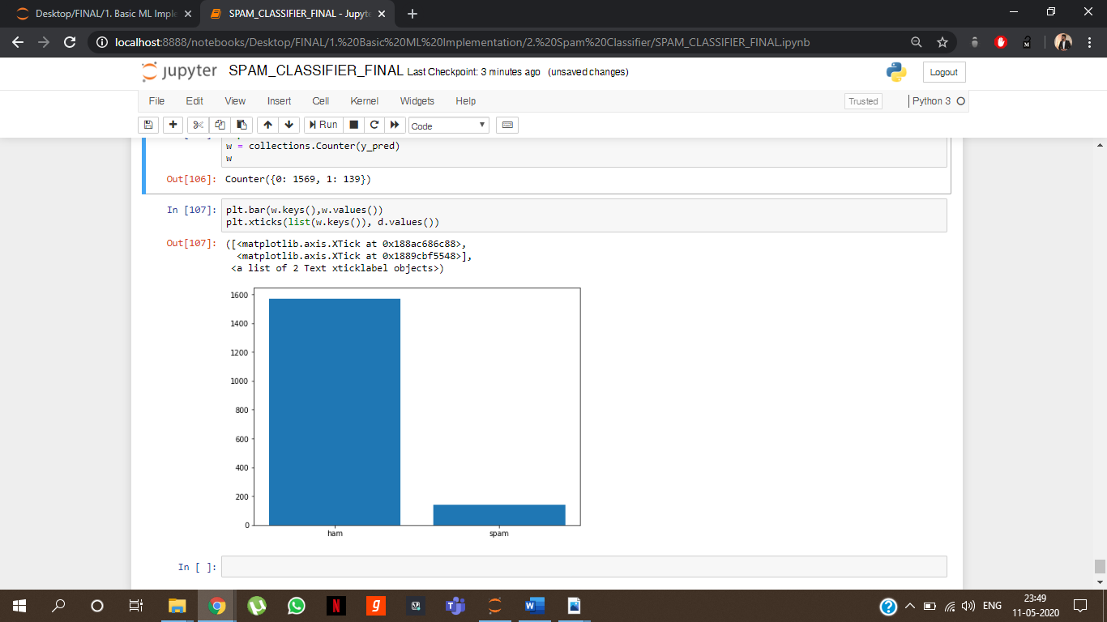
SCREENSHOTS
Accuracy comparison & visualization of test data using bar-chart

Slide 23

THE FINAL ANALYSIS OF MODELS WERE:
MODELS | ACCURACY
Naïve Bayes | 96.43%
Decision Tree | 96.14%
Logistic Regression | 98.30%
K-Nearest Neighbor | 93.44%

Slide 24

CONCLUSION
Best one was the LOGISTIC REGRESSION.
Also, spam mails are a serious concern to and a major annoyance for many Internet users. The mode proposed as a solution in this paper is highly beneficial because it introduces a threshold counter which helps overcome congestion on the web server and also maintain the spam filter efficiency but at the same time, it also requires overhead storage space for the databases.

Slide 25
CREDITS
Special thanks to all the teachers and mentors who have helped, trained and motivated me so that I can work upon these skills and showcase the projects and workings in front of you.

Slide 26

THANKS!
Any questions?
You can find me at
LinkedIn@tusharmahajan21

